Slide 1

Machine Learning Algorithms and Computational Tools Development for Analysis of Sequencing and EMR Data
Shaopeng Gu
Department of Mathematics & Statistics
Oct 30th, 2019

Slide 2
Outlines
Chapter 1
Introduction
Next-Generation Sequencing Data
Chapter 2
Tools Development
Sequencing Data Analysis
Chapter 3
Collaborative Efforts
GeneQC
EMR Data
Machine Learning for Data Analysis
EMR Data Analysis
Chapter 4
Glycine Max RNA sequencing Analysis
Discussion

Slide 3
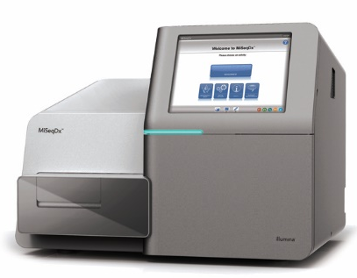
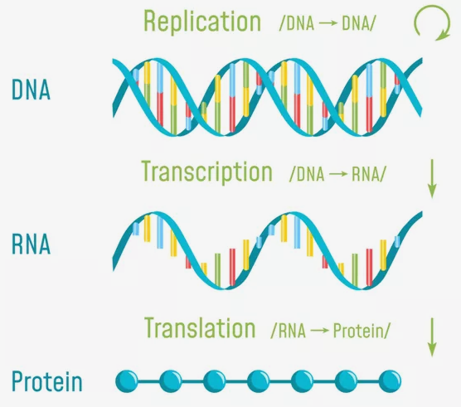
Next-Generation Sequencing (NGS) Data
Friendly Cost
High Speed
High Resolution and Accuracy
Explosive Growth of DNA, RNA, and Protein Sequencing (200 million in NCBI GenBank)

Slide 4

Electronic Medical Record (EMR) Data
EMR Stores Longitudinal Health Information
Treatment history
Medical history
A Comprehensive Picture of A Patient’s Medical History

Slide 5
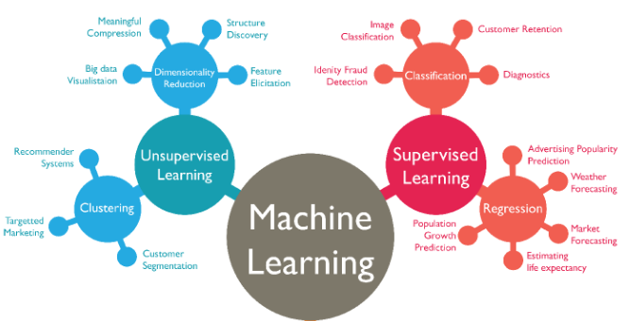
Machine Learning
Supervised Learning
Classification and regression
Unsupervised Learning
Clustering and dimensionality reduction
Reinforcement Learning

Slide 6
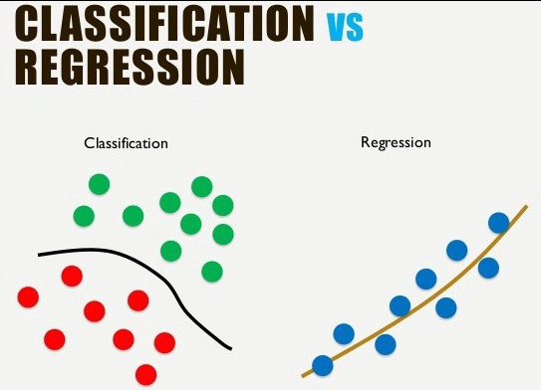
Machine Learning in Data Analysis
Analysis of Biological Sequencing
Structural properties prediction
Functional properties prediction
Drug target development
Fold recognition, etc.
Analysis of EMR Data
Health estimation
Disease prediction
Treatment aid, etc.

Slide 7
Tool Development for Sequencing Data Analysis
Computational Tools are Urgently Needed Because:
Gap exists between sequencing data and their functional annotation (0.3%)
Sequencing data cannot be analyzed by human inspection
High cost of wet laboratory experiment
A Comprehensive Sequencing Data Pipeline tool should:
Covert original sequencing data (Fast) to mathematical matrix for predicting
Accurately and fast implement prediction
Integrate most popular and recent predictors
User-friendly and memory efficient

Slide 8
Overall Designing Idea of Pipeline Tool
Comprehensive Sequencing Data Analysis Tool
Feature
Extraction
Feature Selection or Dimensionality Reduction
Predicting Models Construction
Seq Data
Label

Slide 9
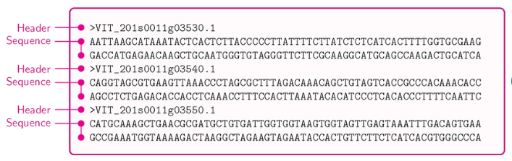
Feature Extraction
Transforming Sequencing Data into mathematical expression
Sequencing property
Physicochemical property
Evolution
Structure

Slide 10
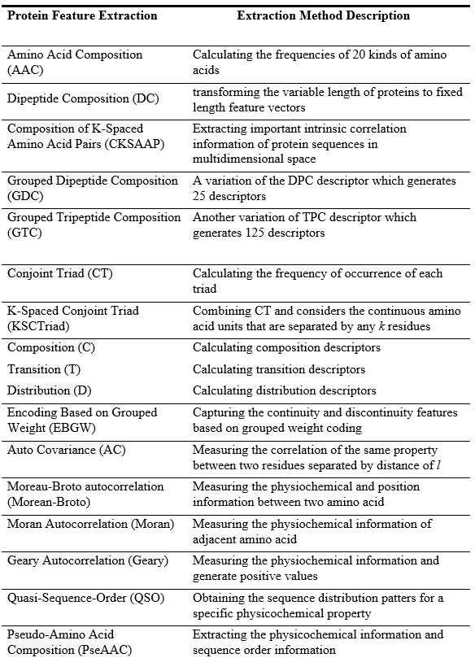
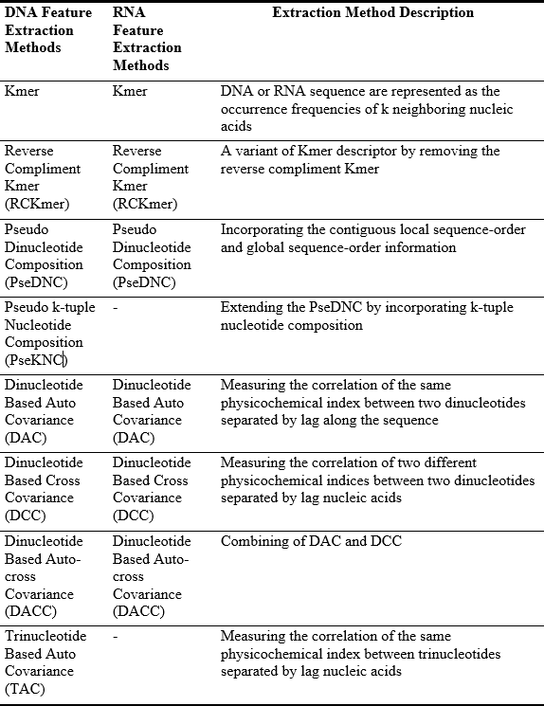
Feature Extraction Methods
16 DNA Feature Extraction Methods
12 RNA Feature Extraction Methods
32 Protein Feature Extraction Methods

Slide 11
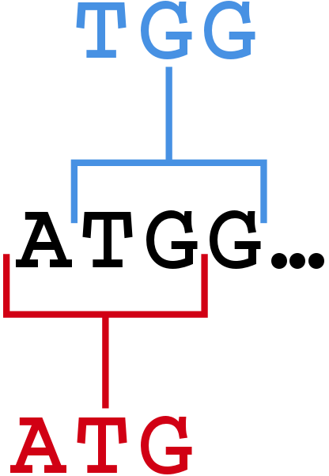
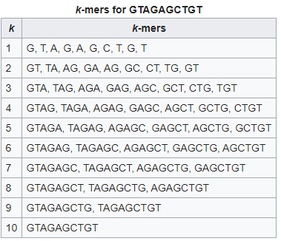

DNA or RNA Feature Extraction - Kmer
Kmers are Subsequences of Length k Contained within Sequence. Sequences are Represented as the Occurrence Frequencies of $k$ Neighboring Nucleic Acids.
The kmer (k=3) descriptor can be calculated as:
$$f\left(t\right)=\frac{N(t)}{N},t∈\{AAA,AAC,AAG,…,TTT\}$$
Notes:
For Kmer descriptor, the DNA sequences are represented as the occurrence frequencies of neighboring nucleic acids. The Kmer (k=3) descriptor can be calculated as:

Slide 12
DNA or RNA Feature Extraction - Kmer
Kmers are subsequences of length k contained within sequence

Slide 13
Protein Feature Extraction - Kmer
Kmers are subsequences of length k contained within sequence

Slide 14
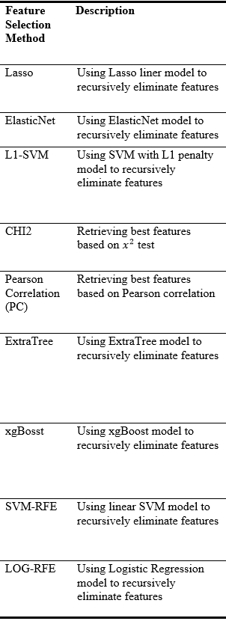
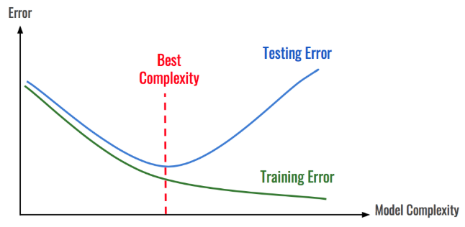
Feature Selection
Extracted feature vectors often show high dimensionality
Selecting those features that contribute most to predictions can
Reduce overfitting
Significantly reduce training time for model construction
Remove noisy features to improve performance of models
20 Feature Selection Methods

Slide 15
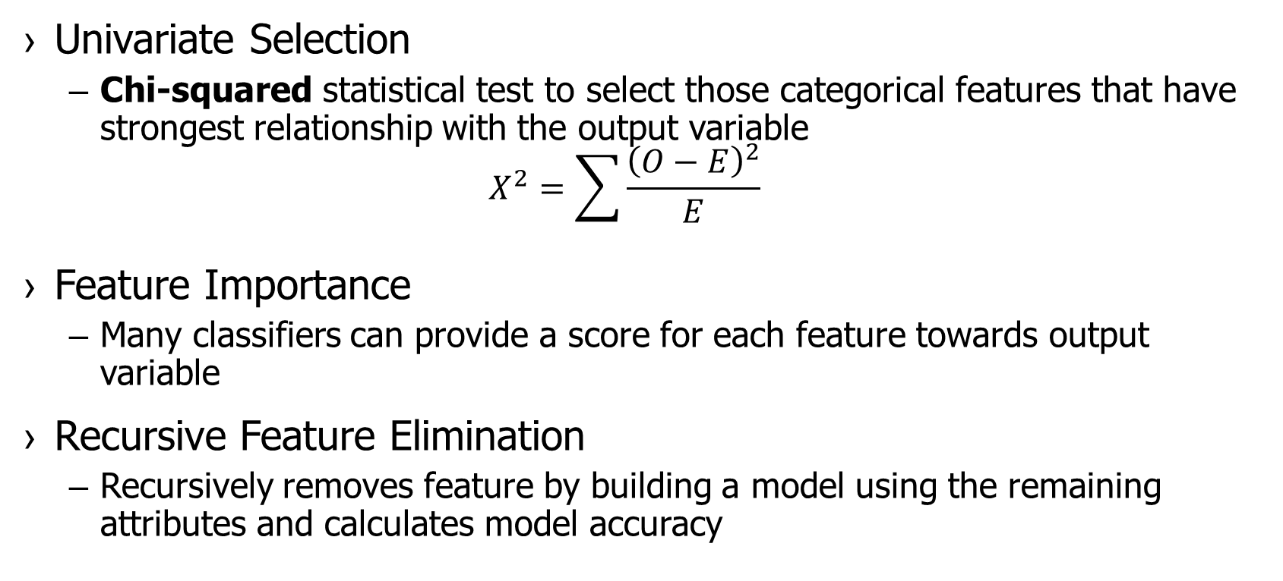
Feature Selection Methods
Univariate Selection
Chi-squared statistical test to select those categorical features that have strongest relationship with the output variable
$$X^{2}=\sum{\frac{{\left(O−E\right)}^{2}}{E}}$$
Feature Importance
Many classifiers can provide a score for each feature towards output variable
Recursive Feature Elimination
Recursively removes feature by building a model using the remaining attributes and calculates model accuracy
Notes:
O is the observed frequency, E is the expected frequency if no relationship between the variables. Chi2 observed in the data and what would be expected if there was truly no relationship between the variables. We calculate Chi-square between each feature and the target and select the desired number of features with best Chi-square scores

Slide 16
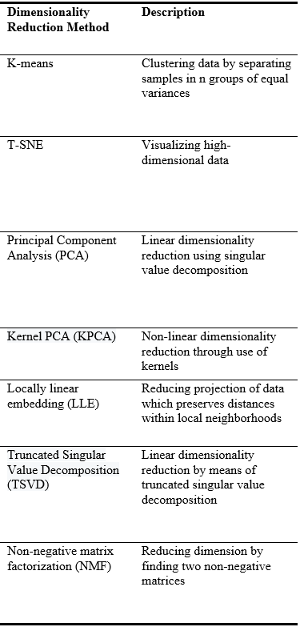
Dimensionality Reduction
Reducing High Dimensionality Data to Low Dimension Based on Data Itself (Unsupervised)
Clustering method
Dimension reduction
For Extremely High-dimension Feature Vectors (Protein)
Reducing data preparation time for modeling
16 Dimensionality Reduction Methods
Notes:
O is the observed frequency, E is the expected frequency if no relationship between the variables. Chi2 observed in the data and what would be expected if there was truly no relationship between the variables. We calculate Chi-square between each feature and the target and select the desired number of features with best Chi-square scores

Slide 17

Dimensionality Reduction Method
Clustering
K-means: partition $n$ observations into $k$ sets to minimize the within-cluster sum of squares
$$\underset{K}{argmin}{\sum_{i=1}^{k}{\sum_{x∈K_{i}}{{\left\|x−μ_{i}\right\|}^{2}}}}$$
Dimension Reduction
T-Distributed Stochastic Neighbor Embedding (t-SNE): maps multi-dimensional data to lower dimension space and find patterns by identifying the observed clusters
Notes:
K-MEANS: where μ_{i} is the mean of points in Ki
TSNE; The algorithms starts by calculating the probability of similarity of points in high-dimensional space and calculating the probability of similarity of points in the corresponding low-dimensional space. then tries to minimize the difference between these conditional probabilities (or similarities) in higher-dimensional and lower-dimensional space for a perfect representation of data points in lower-dimensional space.

Slide 18
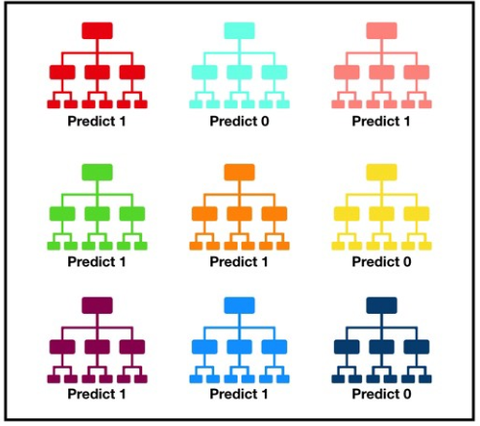
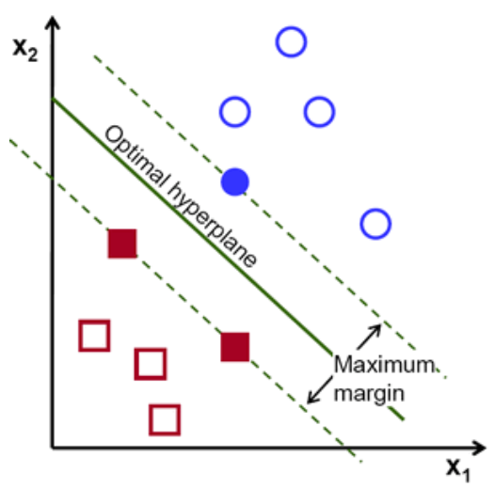

Model Construction
Ten Popular Classifier are included
Support vector machine (SVM): divide separate categories by a clear gap that is as wide as possible
$$\left(\vec{x_{i}},y_{1}\right),…,\left(\vec{x_{n}},y_{n}\right)$$
RandomForest: ensemble a large number of individual decision trees and use majority vote for model’s prediction
KNN, ExtraTree, Adaboost, etc.

Slide 19
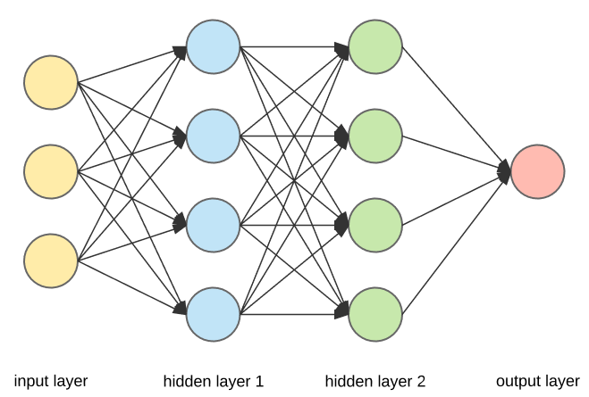
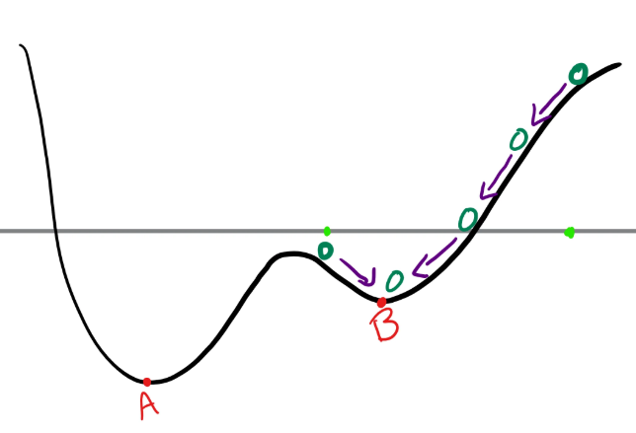
Deep Learning Classification
Three Neural Network Classifier are Included
Artificial neural network are inspired by biological neural network
Notes:
O is the observed frequency, E is the expected frequency if no relationship between the variables. Chi2 observed in the data and what would be expected if there was truly no relationship between the variables. We calculate Chi-square between each feature and the target and select the desired number of features with best Chi-square scores

Slide 20

Model Evaluation
Cross-validation
5 folds cross-validator is used for obtaining classification accuracy and plotting ROC curves
Performance Evaluation
$$Accuracy=\frac{Number of correct predictions}{Total number of predictions}$$
ROC curves
Notes:
Receiver operating characteristic curve plot the true positive rate against the false positive rate at various threshold settings

Slide 21
ALLFEATURE
Notes:
O is the observed frequency, E is the expected frequency if no relationship between the variables. Chi2 observed in the data and what would be expected if there was truly no relationship between the variables. We calculate Chi-square between each feature and the target and select the desired number of features with best Chi-square scores

Slide 22
Prediction Task of DNA Sequencing
DNA N6-methyladenine (6mA) Sites Prediction
Associated with biological processes such as DNA replication, repair, transcription and cellular defense
6mA site-containing sequences from Mus musculus in the MethSMRT database, including 1934 positive and 1934 negative samples
Feature Extraction
T-Distributed Stochastic Neighbor Embedding (t-SNE): maps multi-dimensional data to lower dimension space and find patterns by identifying the observed clusters
Notes:
O is the observed frequency, E is the expected frequency if no relationship between the variables. Chi2 observed in the data and what would be expected if there was truly no relationship between the variables. We calculate Chi-square between each feature and the target and select the desired number of features with best Chi-square scores

Slide 23
SELF-INTRODUCTION Publications
[2019] Zhao Jing, Shaopeng Gu, Adam McDermaid. Predicting outcomes of chronic kidney disease from EMR data based on Random Forest Regression. Mathematical Biosciences .
[2019] Russel Wilke, Mohammad Qamar, Roxana Lupu, Shaopeng Gu, Jing Zhao, Chronic Kidney Disease in Agricultural Communities. The American Journal of Medicine.
[2018] Adam McDermaid, Xin Chen, Yiran Zhang, Cankun Wang, Shaopeng Gu, Juan Xie, Qin Ma, A new machine learning-based framework for mapping uncertainty analysis in RNA-Seq read alignment and gene expression estimation. Frontiers in Genetics.
[2016] Ashish Dubey, Nirmal Adhikari, Swaminathan Venkatesan, Shaopeng Gu, Devendra Khatiwada, Qi Wang, Lal Mohammad, Mukesh Kumar, Qiquan Qiao*, Solution processed pristine PDPP3T polymer as hole transport layer for efficient perovskite solar cells with slower degradation. Solar Energy Materials and Solar Cells.
[2016] Ashish Dubey, Nirmal Adhikari, Swaminathan Venkatesan, Shaopeng Gu, Devendra Khatiwada, Qi Wang, Lal Mohammad, Mukesh Kumar, Qiquan Qiao*, Shelf life stability comparison in air for solution processed pristine PDPP3T polymer and doped spiro-OMeTAD as hole transport layer for perovskite solar cell. Data in Brief.
[2016] Nirmal Adhikari, Ashish Dubey, Eman A. Gaml, Bjorn Vaagensmith, Khan Mamun Reza, Sally Adel Abdelsalam Mabrouk, Shaopeng Gu, Jiantao Zai*, Xuefeng Qian*, Qiquan Qiao*, Crystallization of Perovskite Film for Higher Performance Solar Cells by Controlling Water Concentration in Methyl Ammonium Iodide Precursor Solution. Nanoscale.
Notes:
During my five years’ total research expreiences, I publushed six papers. The first three is published during my master period and last three in bachelor’s period. Most of my research adivosor and collbraotors value me as a hard-working and productive students. In addition, I am good at work with others as a team. I have collbratroed with many great researchers from different institutions.

Slide 24
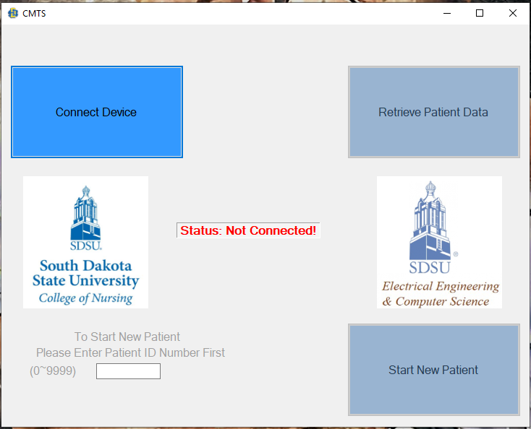
Skills
Strong coding experience in multiple languages
Python, R, Perl, MATLAB, C++
Strong Machine learning knowledge
Supervised: SVM, KNN, Elastic-Net, RandomForest, etc.
Unsupervised: K-means, mixture models, t-SNE, UMAP, etc.
Packages: Sklearn, Tensorflow, Numpy, Pandas, Matplotlib, Scipy, etc.
Strong experience in sequencing data analysis
1T scRNA-seq and 3T bulk RNA-seq data analysis experience
Fastqc, HTseq, Hisat2, STAR, Bowtie2, Ballgown, Deseq2
Seurat, Monocle, SC3, CellRanger, SCENIC, MAST
Strong experience in computer cluster
XSEDE (Founded by NSF, server located in Pittsburgh Supercomputing Center)
CyVerse
SDSU cluster: blackjacks
Notes:
During many years’ work experience, I acculated a lot of knowleges and skills. Frist of all, I had strong coding experience using different programming languages. I am proficient at Python, R and perl. Python is cullently popular programing lanugage because it is powerful and fast for machine learning. I developed three python tools for my research projects. R is another popular lanuage which is suited for statical computing and graphs and I manily used R for staticscal modeling. Perl is good for data mining because it is easy to extract information from sequencing data at different levels. During my undergrauate period, I mainly used C++ and Matlab. For my senior design project, I used C++ to develop a windows software for SDSU, college of nursing, which can retreive timestamp data using USB communication methods from a cortisol measurement timestap device. With this software and our device, patients do not need spend two days in a medecal center to collect cortisol. They do cortisol measurment at home and the device will mointor their the what time they do the meareuemnt. I am also well trained in machine learning. I applied a lot of machine learning methods for my research projects includes some supervised methods, SVM, KNN, Elastic-Net, RandomForest and many others. I am also capable for unspervised learning methods such as Kmeans, mixture models, TSNE. Tsne is well suited for viluallzation for high diminonal data. It can be applied for imiage processing, genomic data and natural language processing. Tsne maps the multi-diminsonal data to a lower diminson space and try to find patterns by identifying the observed clusters. Most of signle-cell pipeline includes this technique. I recently heard new diminsonl reduction method called UMAP. It is similar to tsne but a recent publications show is has faster running time and can generate meaningfull organization for cell type. Machine learning is still growing and I can expected that there will have more advanced methods in the future. I am always eargr to learn them.
I analyzed more than 1T scRNA-seq and 3T bulk RNA-seq data of plant and animial species. I am faimilar with follwing popular tools: fastqc for quality control, Htseq for feature counts, Hisat2, STAR, Botiew2 for read alignment, DESEQ2 and Bollgown for differential expresiion analysis.

Slide 25
RESEARCH PROJECTS
Predicting outcomes of chronic kidney disease from Electronic medical records (EMR) data
A feature extraction and selection Python tool for sequencing data
Single-cell RNA-seq data analysis
A new Machine learning-based framework for mapping uncertainty analysis in RNA-seq read alignment and gene expression estimation
Notes:
Therefore, my main research interests is to develop computational tools to help researchers to understand bioinformatics and biomedical data better.

Slide 26
PREDICTING OUTCOMES OF CKD FROM EMR DATA
Stage of chronic kidney disease (CKD) is defined by estimated glomerular filtration rate (eGFR)
CKD can be predicted if future eGFR can be accurately estimated
Early identification of CKD have potential to
Reduce number of patients progressing to End Stage Renal Disease
Lower mortality rate and healthcare costs
Predicting models were built by data extracted from a regional health system, Sanford
120,495 patients aged from 20 to 80 in Sioux Falls, SD

Slide 27
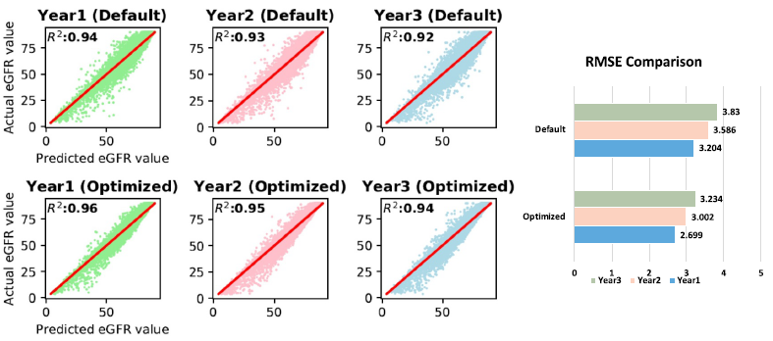

PREDICTION RESULTS
eGFR prediction is evaluated by $R^{2}$ and Root of Mean Squared Error

Slide 28
RESEARCH PROJECTS
Predicting outcomes of chronic kidney disease from Electronic medical records (EMR) data
A feature extraction and selection Python tool for sequencing data
Single-cell RNA-seq data analysis
A new Machine learning-based framework for mapping uncertainty analysis in RNA-seq read alignment and gene expression estimation
Notes:
Therefore, my main research interests is to develop computational tools to help researchers to understand bioinformatics and biomedical data better.

Slide 29
OVERVIEW OF TOOL
LABEL
Data
Feature Extraction
42 types of descriptors
Unsupervised method
8 methods
Supervised Selection
17 methods
Performance Evaluation
6 methods
Output
DNA
kmer
DAC
TAC
10
more
PCA
CHI2
Random Forest
Selected Feature Vectors
LLE
LASSO
KNN
DR
Results
Vectors
RNA
kmer
DAC
DCC
6
more
SVD
ReliefF
SVM
DAC
ACC & ROC
Results
Factor Analysis
Mutual Information
Neural
Network
Protein
AAC
PAAC
DPC
17
more
Best model selection
4 more
13 more
2 more

Slide 30
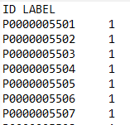
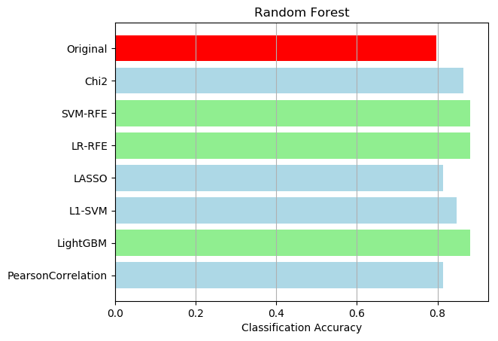
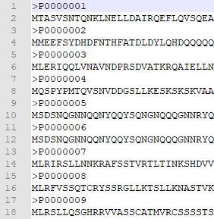
APPLICATION
Predicting whether a protein is contained in chloroplast
Feature
Extraction
(AAC)
Feature
Selection

Slide 31
RESEARCH PROJECTS
Predicting outcomes of chronic kidney disease from Electronic medical records (EMR) data
A feature extraction and selection Python tool for sequencing data
Single-cell RNA-seq data analysis
A new Machine learning-based framework for mapping uncertainty analysis in RNA-seq read alignment and gene expression estimation
Notes:
Therefore, my main research interests is to develop computational tools to help researchers to understand bioinformatics and biomedical data better.

Slide 32
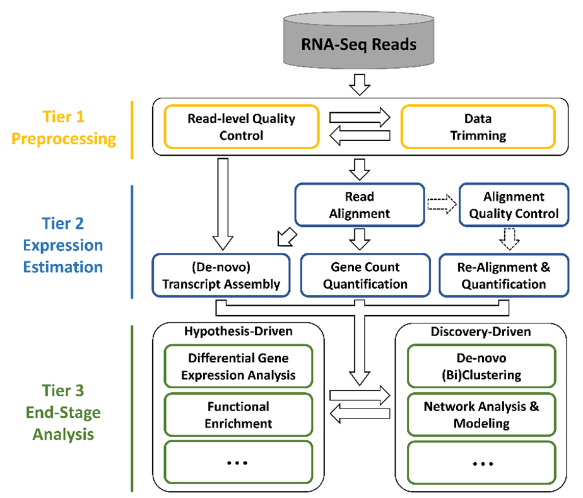
SINGLE-CELL RNA-SEQ ANALYSIS
Single cellular resolution
Recognize cell heterogeneity
Issue – dropouts (highly sparse)
Major research areas:
Cell type prediction
Cell trajectory analysis
Psudotime
Spatial position identification
Hierarchy structure
Cell type specific regulatory network
etc…
Notes:
Recent advances in analyzing tissues and organs at the single cell level are revolutionizing our understanding of organ development, biology, and disease. The traditional bulk RNA-seq loses information on the heterogeneity of individual cells. scRNA-Seq from individual cells preserves heterogeneity, and technological advances have made these techniques highly accessible. They are now utilized in a significant percentage of biological studies to report finding such as more precise quantifications of cell composition, the discovery of previously unknown or rare cell subtypes, and highly detailed descriptions of cell fate trajectories.
Due to the limitation of sequencing techniques, one critical issue of scRNA-seq analysis is the dropout, meaning that large quantity of zeros exist. The highly sparse expression data makes the analysis similar but also differ than the traditional bulk RNA-seq data, and so that, many tools and pipelines have been developed specifically designed for scRNA-Seq data analysis, such as Seurat, Monocle, SC3, etc.
In general, the three steps are included in a scRNA-seq analysis pipeline: mapping alignment, preprocessing, and advanced analyses. The first step is similar to bulk RNA-seq analysis, some bulk tools are even compatible for single-cell analysis, such as STAR and bowtie2. Preprocessing step treats the expression matrix by filtering low-quality genes and cells and normalizing expression values by some distributions. Currently, the cutting-edge researches of scRNA-seq analysis focus on the following areas: Cell type prediction, Cell trajectory analysis, Psudotime, Spatial position identification, Hierarchy structure, Cell type specific regulatory network, and etc…

Slide 33
CELL TYPE PREDICTION FROM scRNA-seq
Comparing the accuracy and goodness in predicting cell types among six existing pipelines/tools.
Data: 15 scRNA-Seq datasets with cells ranging from 49 to 3005 and genes from 10,000 to 40,000. Including two 10X data and 1 smart-seq data.
Tools: SC3, SCENIC, Seurat, Monocle, BackSPIN, Sincera
Result: Seurat is the most powerful tool (multifunctional) with highest prediction scores (adjusted rand index)
Notes:
One of my collaborative project was to use different scRNA-Seq analytical tools to test the their cell type prediction. I helped the team by learning and testing six single-cell integrative tools including SC3, SCENIC, Seurat, Monocle, BackSPIN, and Sincera.
(把ppt上的念一念就行了)

Slide 34
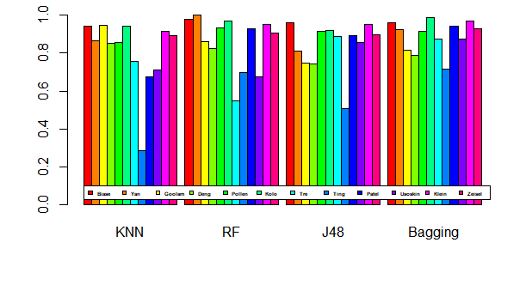
CELL TYPE CLASSIFICATION FROM scRNA-seq
Also tested four supervised machine learning methods
TP rate of four classification methods based on expression data
Notes:
I also have tested four supervised machine learning methods, KNN, Random forest, J48, and bagging, for their clustering performance in cell type identification. The test showed that in general, Bagging method performs better that the other three. Also, the difference among datasets is huge, such as number of cells, complexity of cell types, dropout percentage so that it is hard to find a robust method that can have good clustering performance for any dataset.

Slide 35
RESEARCH PROJECTS
Predicting outcomes of chronic kidney disease from Electronic medical records (EMR) data
A feature extraction and selection Python tool for sequencing data
Single-cell RNA-seq data analysis
A new Machine learning-based framework for mapping uncertainty analysis in RNA-seq read alignment and gene expression estimation
Notes:
Therefore, my main research interests is to develop computational tools to help researchers to understand bioinformatics and biomedical data better.

Slide 36
GENEQC
A machine learning-based tool for mapping uncertainty analysis and gene expression estimation
Notes:
Most RNA-seq studies perform read alignment without much concern for the quality of the alignment results, assuming them to be of sufficient quality. However, our investigation has shown that mapping uncertainty is a prominent issue with the quality of alignment results. We tested 95 datasets the total size about 2T. Each dataset was aligned using HISAT2, against the appropriate reference genome. Alignment statistics were collected or calculated from the HISAT2 output file. It was determined that an average of 22% of all reads were ambiguously aligned in each of the seven distinct plant and animal species. Just as most RNA-seq pipelines use some quality control method for raw reads, a quality control process for read alignment must be included to verify the reliability of mapping results. Therefore, we developed this alignment control tools. In GeneQC, we extract usable features from two genetic levels, genomic and transcriptomic. These three levels of information are combined using linear modeling to develop a distinct score, referred to as the D-score, to provide a clear measure of the level of mapping uncertainty for each annotated gene for a particular species. Additionally, mixture model distributions are used to determine categorizations for the mapping uncertainty and provide recommendations for which genetic expression estimates are reliable following the read alignment step.

Slide 37
ACKNOWLEDGEMENT
Researcher | Title | Institution/Company
Dr. Qiquan Qiao | Professor | South Dakota State University
Dr. Ashish Dubey | Analyst & Engineer | Daktronics
Dr. Zhen Ni | Assistant Professor | South Dakota State University
Dr. Qin Ma | Associate Professor | The Ohio State University
Dr. Adam McDermaid | Computational Medical Informatics Analyst | Sanford Health
Dr. Bin Yu | Associate Professor | Qingdao University of Science & Technology, China
Dr. Sen Subramanian | Associate Professor | South Dakota State University
Dr. Xijin Ge | Associate Professor | South Dakota State University
Dr. Russell Wilke | Dean of Medical School | University of South Dakota

Slide 38
THANK YOU!

